Slide 1
NON-COLLISION DATA STRUCTURES: A QUALITATIVE STUDY OF DATA STRUCTURES FOR COLLISION PREVENTION WITH ROBOTIC BEES
Mateo Sanchez
Juan Felipe Londoño
Juan Pablo Giraldo
Medellín, May 21st 2018

Slide 2
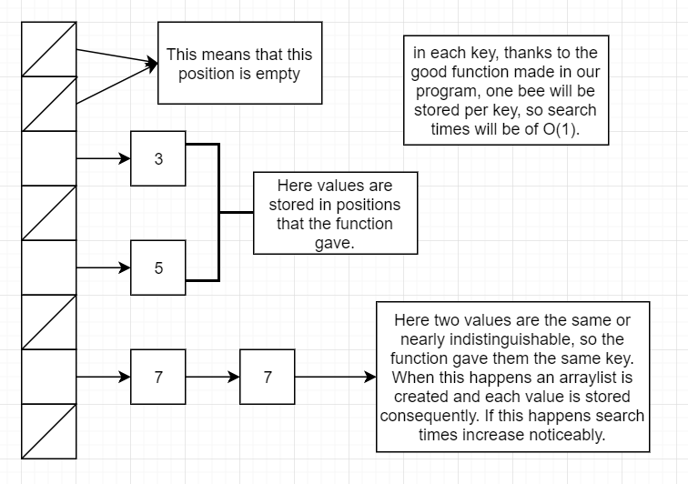
Designed Data Structure

Slide 3
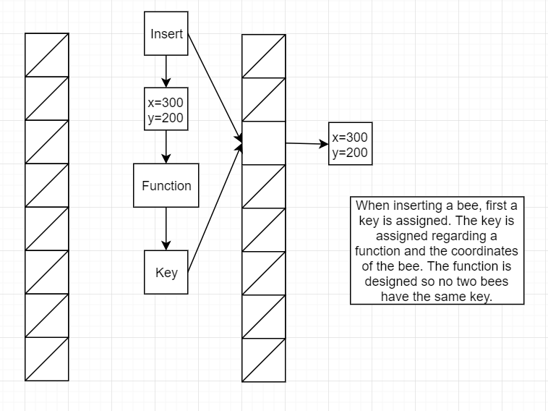
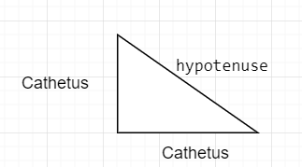
Data Structure Operations
Figure 2: CalculateDistance: Applies the Pythagorean Theorem, first it obtains the positions in X and Y for the two bees. To compare, subtract the b-a to obtain the value of the side of the triangle known as cathetus.
Figure 1: Insert Function

Slide 4
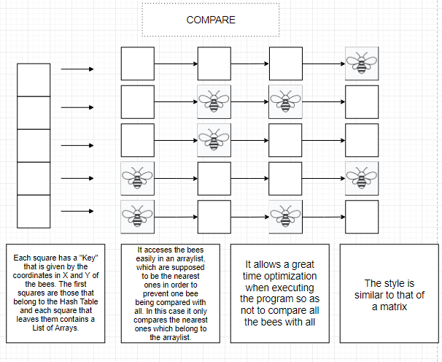
Data Structure Operations
Methods | Complexity
Insert | O(1)
Compare | O( nLog n)
CreateBee | O(1)
CalculateDistance | O(nLog n)
Figure 3: Complexity of the operations
Figure 4: Compare

Slide 5
Design Criteria of the Data Structure
At first, this data structure was taken into consideration because of its efficiency in order to compare different nodes which in this case it is very necessary because of the amount of points that have to be checked. The problem with the quad tree is that there may be some collisions that are not detected because to objects may be colliding but in different quadrants.

Slide 6
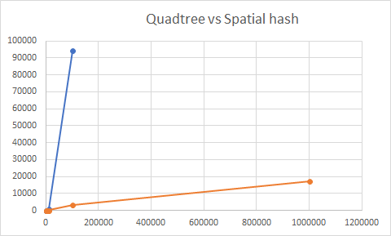
Time and Memory Consumption
Y axis: Amount of time
X axis: Amount of bees
Orange: Spatial Hash
Blue: Quadtree

Slide 7
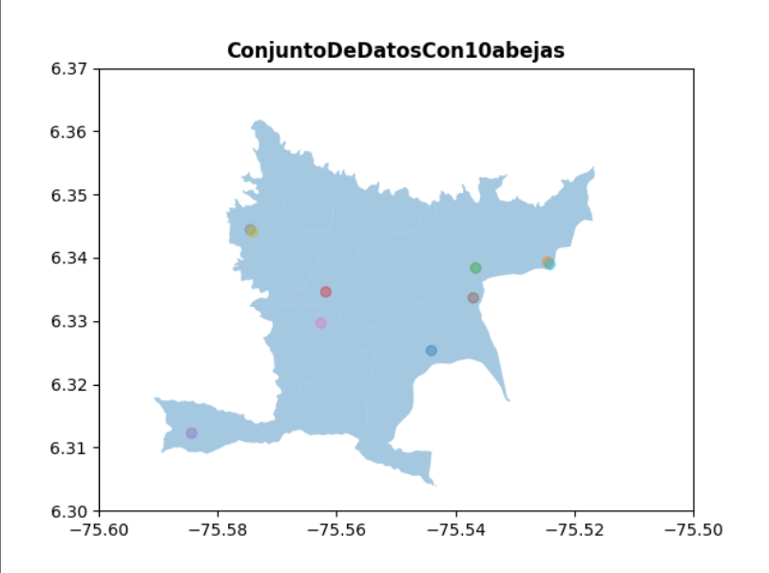
Implementation
Figure 4: Map with ten bees. Circled in red are the bees that collide.

